Slide 1
Prediction Model for PM 2.5
CEE154/254
Carson Chan, Jing Hu, Weize Ou, Haocheng Fan, Yang Shen
Notes:
Good morning everyone, I am Carson Chan, xxxx.

Slide 2
Introduction
01

Slide 3
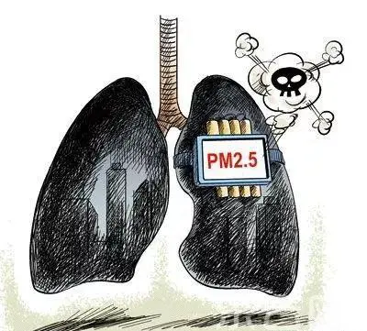
Motivation
Figure from https://sdxw.iqilu.com/share/YS0yMS02Nzc3MTk.html
Particles Matters 2.5
Notes:
Air quality is a critical factor influencing the health and well-being of urban populations. Accurate prediction helps in assessing potential health risks associated with air pollution, allowing authorities to implement timely measures to protect public health.

Slide 4

Problem Statement
Short Term Prediction
Long Term
Prediction
Interpolation
Data
Data
Data
Notes:
To better confine our scope of work, we are predicting PM 2.5 concentrations in short-term, long-term, and interpolation scenarios.

Slide 5

Challenges
Handle Missing and Noisy Data
Capture Underlying Patterns
Parameters Tuning
Notes:
Let’s talk about the challenges we've encountered. The first one is handling missing and noisy data. Imagine having a puzzle where some pieces are missing, and some are simply wrong. This poses a significant challenge in capturing the complete picture of urban air quality. A lot of data pre-processing are required. Second, we need to deal with a lot of predictor variables in the model. The relationship between each independent variable is unknown and may be hard to observe.
Lastly, we did spend quite a lot of time on fine tuning the model.

Slide 6
Literature Review
02

Slide 7
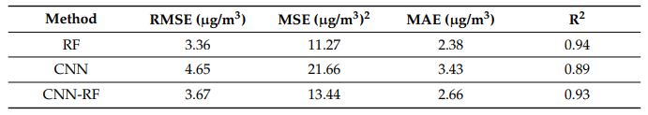
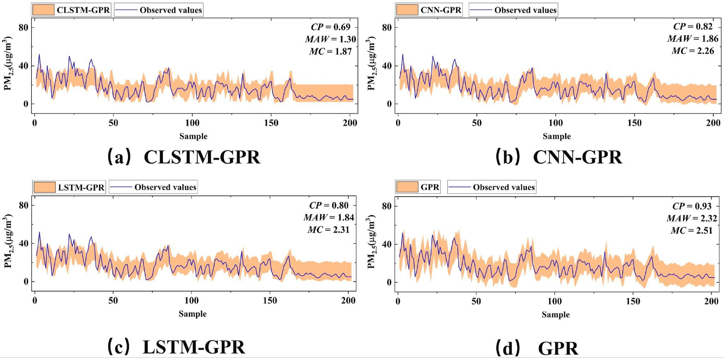
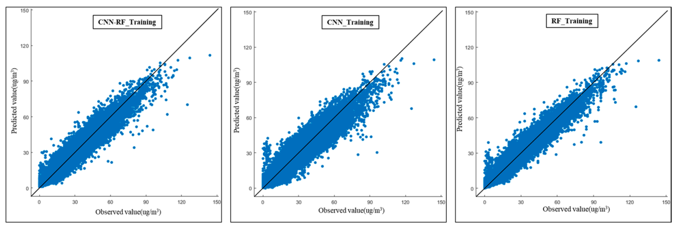
Literature applied models
CNN-RF
CLSTM-GPR
Combines Convolutional Neural Networks with the Random Forest algorithm
CNN with long short-term Memory networks.
Refined by Gaussian Process Regression
PM2. 5 Concentration Prediction Model: A CNN–RF Ensemble Framework. (2023)
Prediction of PM2.5 concentration based on the weighted RF-LSTM model. (2023)
Machine learning and deep learning-driven methods for predicting PM2.5. (2022)
A hybrid CLSTM-GPR model for forecasting particulate matter (PM2. 5). (2023)
Prediction of PM2.5 concentrations using soft computing techniques for the megacity Delhi, India (2022)

Slide 8
Methodology
03

Slide 9
Data Description
Short Term Prediction
Long Term
Prediction
Interpolation
time | hmd | spd | tmp | lat | lon
'2018-10-11 18:00:01' | 36.80 | 0.2300 | 30.60 | 23.05 | 113.1
pm2d5
24.09
Notes:
We are given the time, temperature, humidity, speed of sensor, and location of sensor. we are to predict the PM2.5 value from these variables.

Slide 10
Data Pre-processing
Splitted static sensor data
Take Average & fill-missing
Step 02
Step 04
Step 01
Step 03
Remove outlier
Moving-average
Notes:
There are four steps in total of our data pre-processing part. The first method we adapted is that we decided to only focus on the static sensor. Our choice are made based on the two reasons. First, the mobile data is really messy, though we can clean the data and make it our input for the model, the output will not be that good, just like the professor Noh said in the class, “garbage in, garbage out” . then since there are different static sensor collecting the pm2.5 information, we can still get the information for the relationship between location and the pm2.5 value. therefore, we decided to discard the mobile sensor data. As a result, we write the function to split the data from different static sensors, and try to clean them separately. The reason why we try to split the data from different sensor is that since it is a time-series based prediction, if there is multiple values of pm2.5 at the same time, our data pre-processing part will make no sense. after that, our routine of cleaning the data is shown, remove outliers for the extreme value, then we take different time interval averages according to the performance of each prediction model.Then we applied fill-missing function to fill some missing data. at the last step, we applied moving-average method, the time window for the random forest model is 30 minutes and for GRP model, it’s 50 minutes . After these pre-processing methods, we combined the processed data for the input of our prediction model.

Slide 11
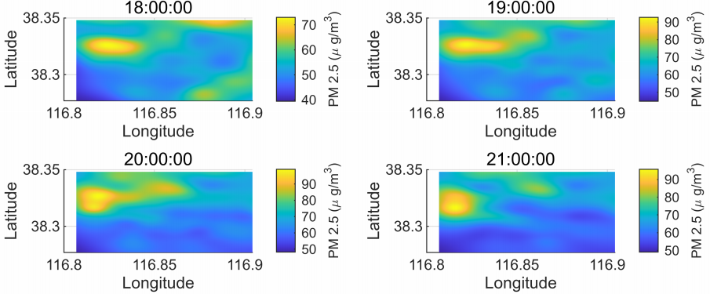
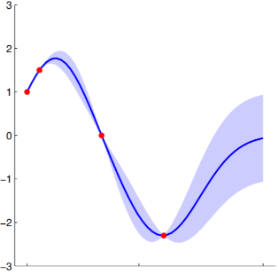
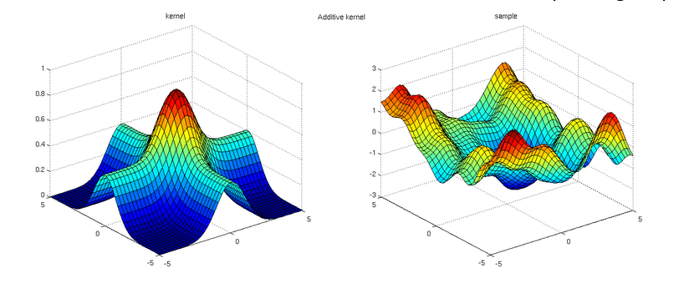
Model 1: Gaussian Process Regression (GPR)
Spatio-temperal data
Multiple dimension data
Why GRP?
GPR takes into account the spatio and temperal correlation within the data.
2D
A GP is an infinite-dimensional object, allowing for multiple inputs.
3D

Slide 12
Model 1: Gaussian Process Regression (GPR)
01
02
03
GOAL
HOW TO TRAIN THE MODEL
TRAINING ENVIRONMENT
04
PERFORMANCE METRIC
Do short term prediction and interpolation
Use posterior (train data) to approximate the distribution function of pm2.5.
Matlab.
NRMSE.

Slide 13
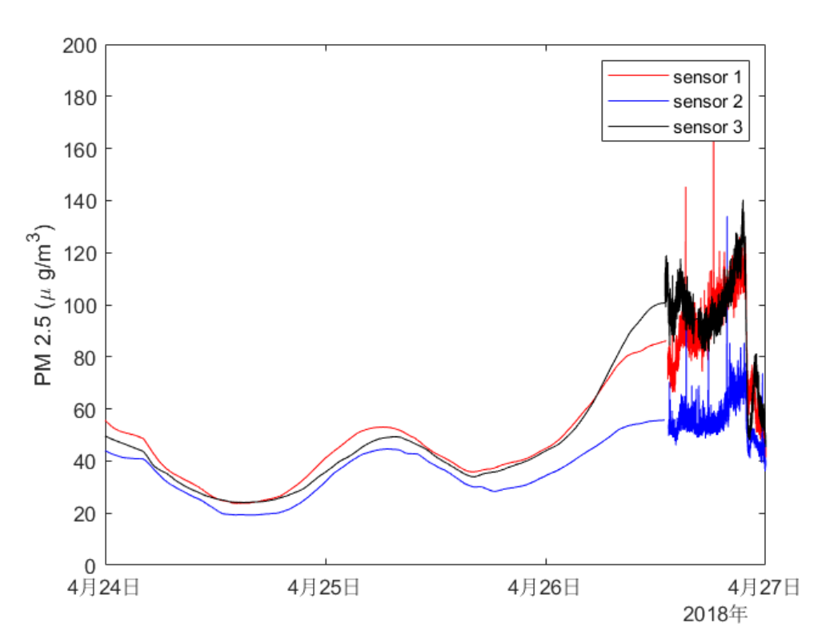
Model 1: Gaussian Process Regression (GPR)
Training dataset
Validation stage
Validationdataset
First 80% of the data in chronological order
(preprocessed)
Last 20% of the data to validate the performance of extrapolation
Dataset dividing strategy

Slide 14
Model 1: Gaussian Process Regression (GPR)
Selecting the parameters
Validation stage
Kernels functions:
exponential | squared exponential | matern32
0.1306 | 0.1354 | 0.1472
NRMSEs for different kernels functions
Input dimensions:(time + longitude + latitude + ...)
humidity | speed | temperature | humidity+speed | humidity+temp
0.1306 | 0.1601 | 0.1732 | 0.1698 | 0.2015
NRMSEs for different Input dimensions
Moving-mean window width: 10 minutes

Slide 15
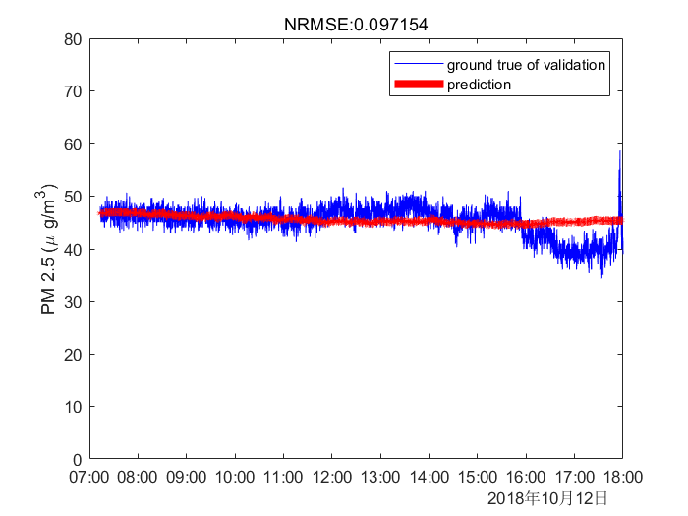
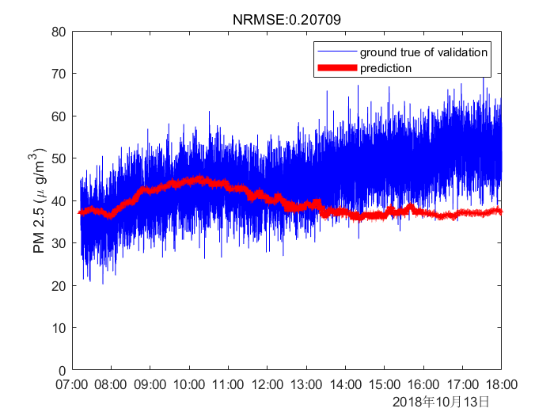
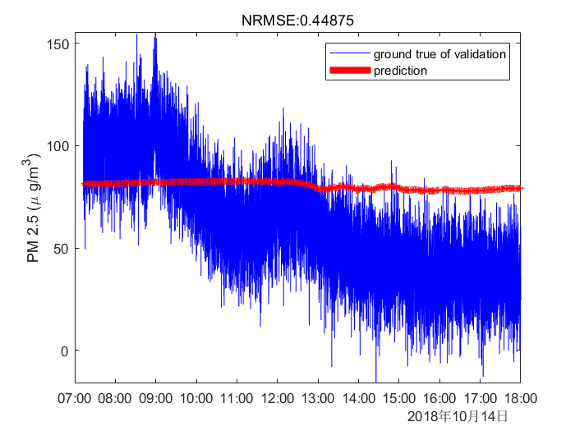
Model 1: Gaussian Process Regression (GPR)
Results
0σ
0.5 σ
1.0 σ
Observations:
-GPR works pretty well in the first 5 hours when the noise level is low.
-High level noise may prevent GPR from learning the details of the data.
-If the prediction period is long, the accuracy decreases.

Slide 16
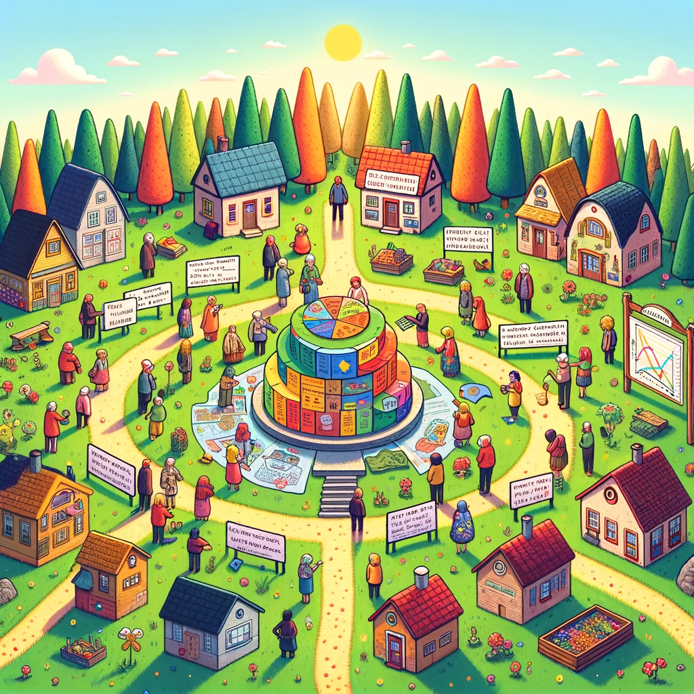

Model 2: Random Forest (RF)
Notes:
Setting: A small village needs to decide where to build a new community center. The villagers decide to use a 'Random Forest' approach for this decision.
Characters: Instead of one person, a group of villagers (each representing a decision tree) is consulted. Each villager has expertise in different areas like geography, local history, community needs, etc.
Process:
Step 1 (Random Sampling): Each villager (decision tree) is given a different set of information (a random sample of the overall data) about the village. For example, one might get data about the population distribution, another about historical sites, another about the land quality, etc.
Step 2 (Individual Decisions): Based on their unique set of information, each villager proposes a location for the community center. Their individual decisions are based on their expertise and the data they have.
Step 3 (Creating a ‘Forest’): All these individual proposals are collected. Each proposal is like a tree, and together, they form a 'forest' of decisions.

Slide 17
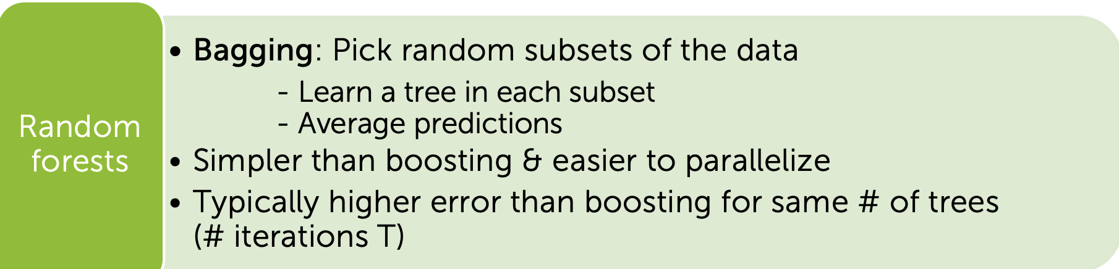
Model 2: Random Forest (RF)
Theoretical Advantages compared to
Other non-linear Model:
Robustness to overfitting with noisy data.
Handle missing value and not need strict data preprocessing.
No iteration- faster than boosting/ batched algorithms.
Drawbacks:
Complexity for Short-term and Interpolation Problem.
Variability in training results across different runs.

Slide 18
Model 2 RF Test Result:
Observations:
Strong ability in robustness to noise.
2. High difference between validation and tesing error: RF is still kind of complex.
Dataset | Validation error | Testing error
Dataset_1 | 0.1562 | 0.3418
Dataset_2 | 0.3196 | 0.4032
Dataset_3 | 0.2032 | 0.3836

Slide 19
Conclusion

Slide 20
Conclusion
Problem Statement
Methodology
Results
Discussion
Future Work
Notes:
Here is the conclusion of today’s presentation. We predicted the PM2.5 concentration using two machine learning methods, namely the Gaussian Process Regression and Random Forest. In the future, it could be interesting to use other more computer model to do the prediction.

Slide 21
Thanks! Q & A

